Slide 1
“Smart Home Technology
& Greek Consumers”
University of Macedonia Department of Applied Informatics
Team members:
Vasileios Kostopoulos
Charalampos Stefanos Papaioannou
Petros Binis
Professor: Zoe Kantaridou

Slide 2
Introduction
Smart homes are residences equipped with interconnected devices and systems, that aim to increase the user’s comfort, security and entertainment while also providing him with energy information as well as the ability to remote control the devices.
Some examples include:
Smart lighting
Entertainment devices
Security cameras
Voice assistants
Smart household appliances
Smart thermostats
Smart locks

Slide 3
Benefits
Barriers
Time saving
Reduced energy consumption
Improve people’s well being(companionship, support, assistance)
Control and Monitoring Services
High cost in purchasing, installing and maintaining all the different devices
Personal data breach
Lack of legal coverage

Slide 4
Purpose of the Study
Investigate the degree of acceptance of smart home technology services by Greek consumers
Record the benefits and disadvantages of using smart home technology services
Investigate the factors that affect the acceptance of smart home technologies in Greece.

Slide 5
Methodology
Designing in the research and questionnaire - gathering data - analyzing the data - drawing conclusions
Convenience Sampling was selected with 108 useful questionnaires
Questionnaire: a) demographics
b) 23 scale questions regarding the factors that influence the adoption of smart technology (5 point Likert scale)
c) participants were able to indicate which benefits and barriers of the smart home technology are most important to them & which household devices they use, would use & will use
Statistical analysis was performed in SPSS

Slide 6
Main Results
General Perceptions
Smart technology is generally considered easy to use, compatible and useful, especially for elderly people
Recognized cost-saving benefits of smart devices
Low degree of influence from social environment
Trust in electronic information services, not as much in telemedicine or payment methods
High level of perceived enjoyment

Slide 7
Technology and Social Groups
Not significant differences in intention to use smart technology among ages and educational levels
Higher intention to use such technology from males
Connection between high incomes and expression of usefulness
Lower degree of social influence from lower incomes

Slide 8
Our Own Study

Slide 9
Methodology
• The questionnaire used in this survey was based on the original one used in the article
• Online questionnaire (Google Forms)
Final sample consisted of 20 useful questionnaires
Demographic questions
33 statements about the preferences, abilities, beliefs and intents of participants
5 - point Likert scale (from 1 to 5) declaring the degree of agreement and disagreement

Slide 10
Findings

Slide 11
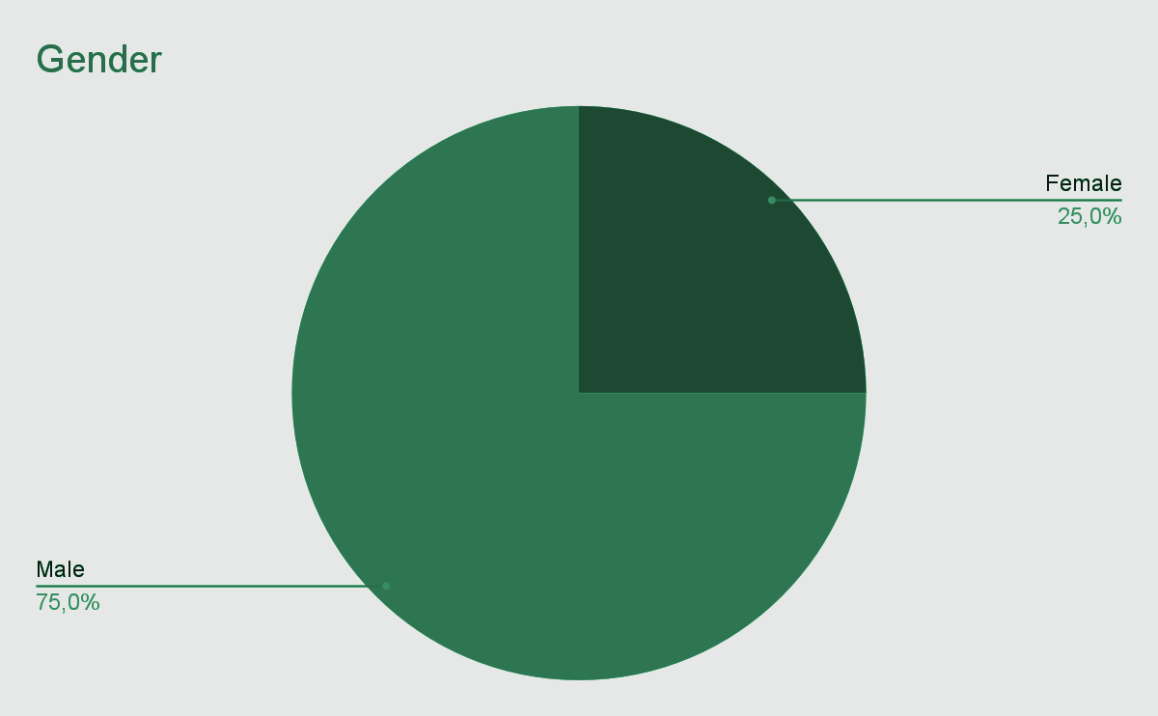
The participants (n = 20) were mostly males (75%) (females, 25%)

Slide 12
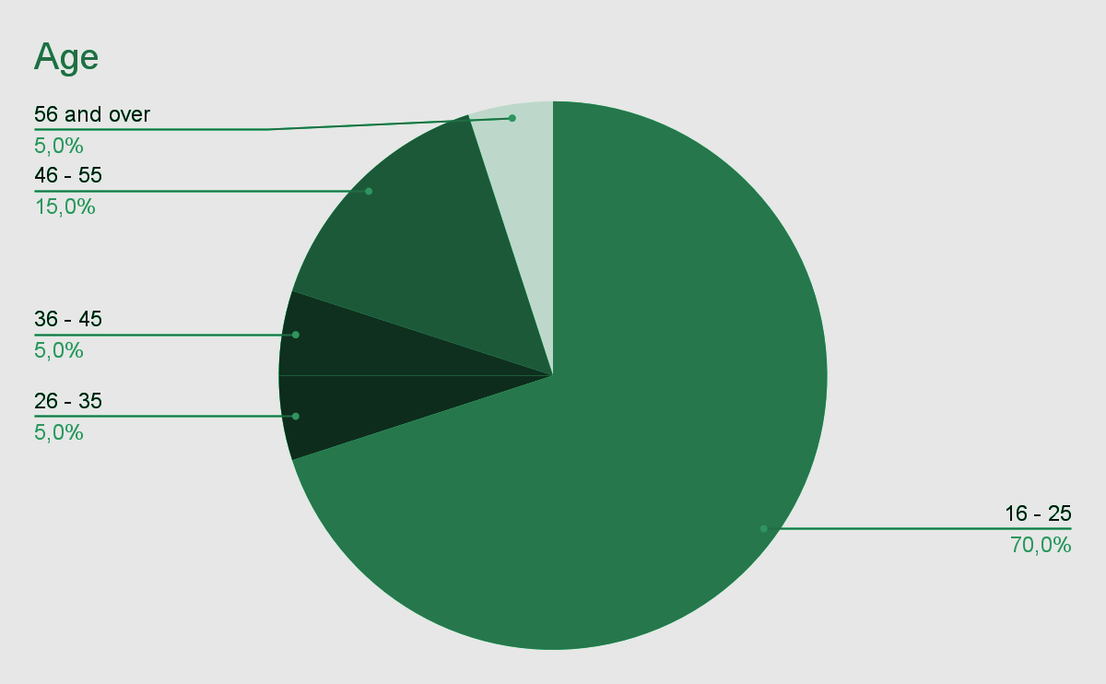
The majority of participants (70%)(n = 14) were between the ages of 16 - 25

Slide 13
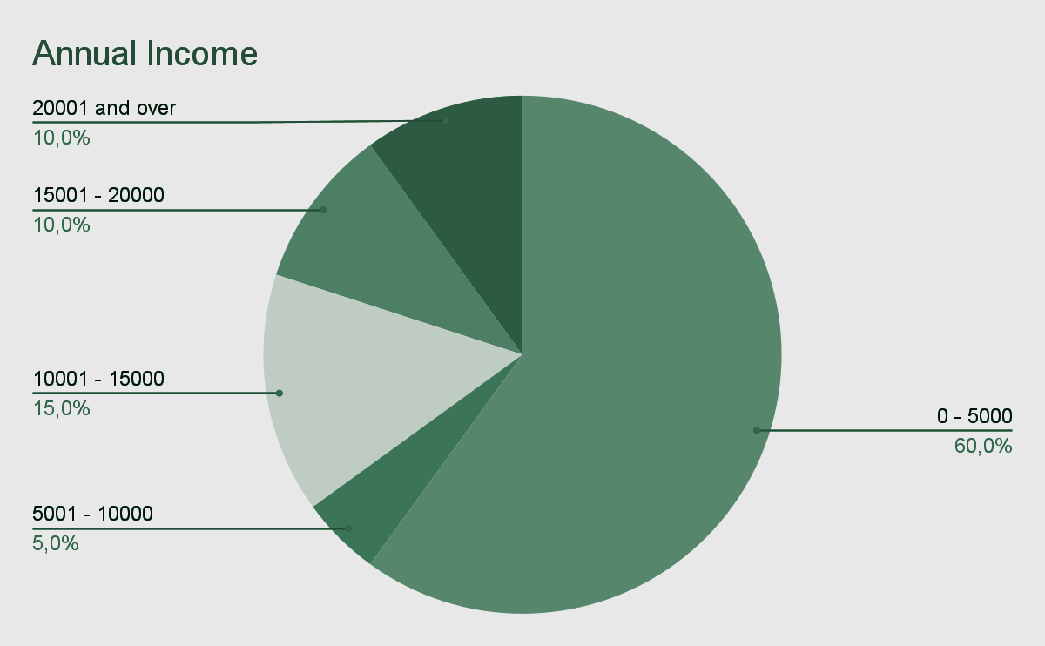
60% (n = 12) of participants earned 0 - 5000 euros annually

Slide 14
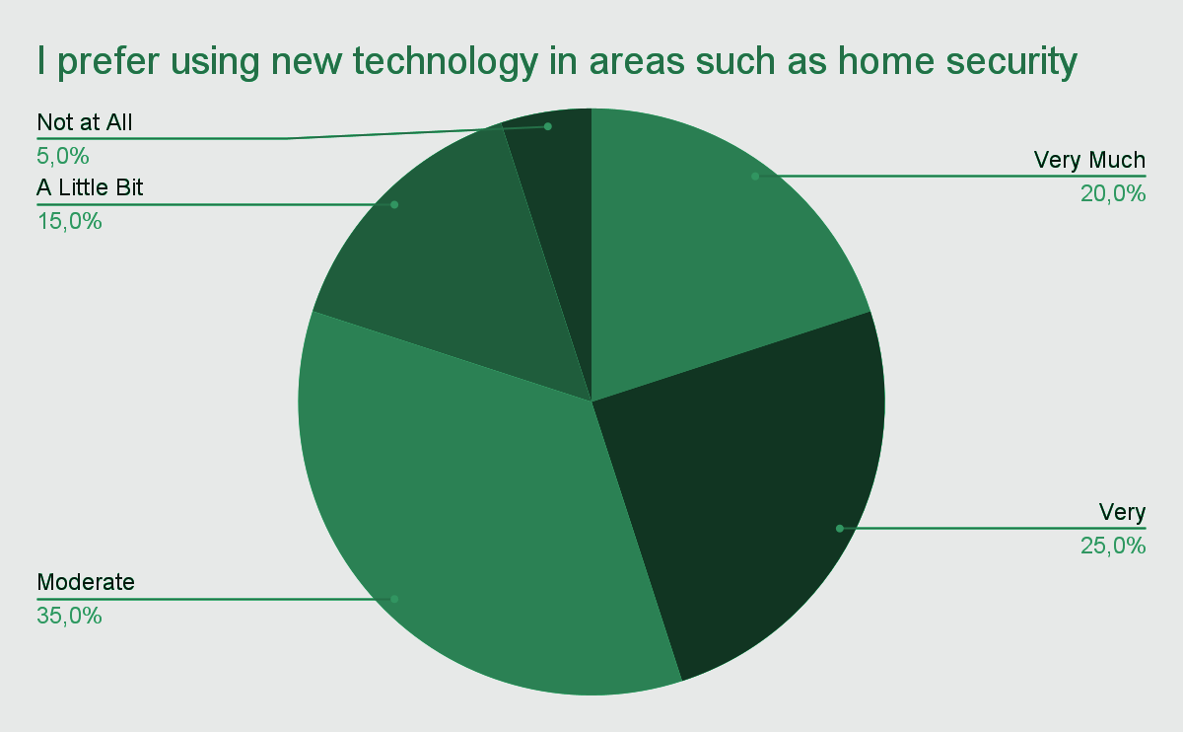
The vast majority of participants showed a preference for the use of new technology in regards to home security

Slide 15
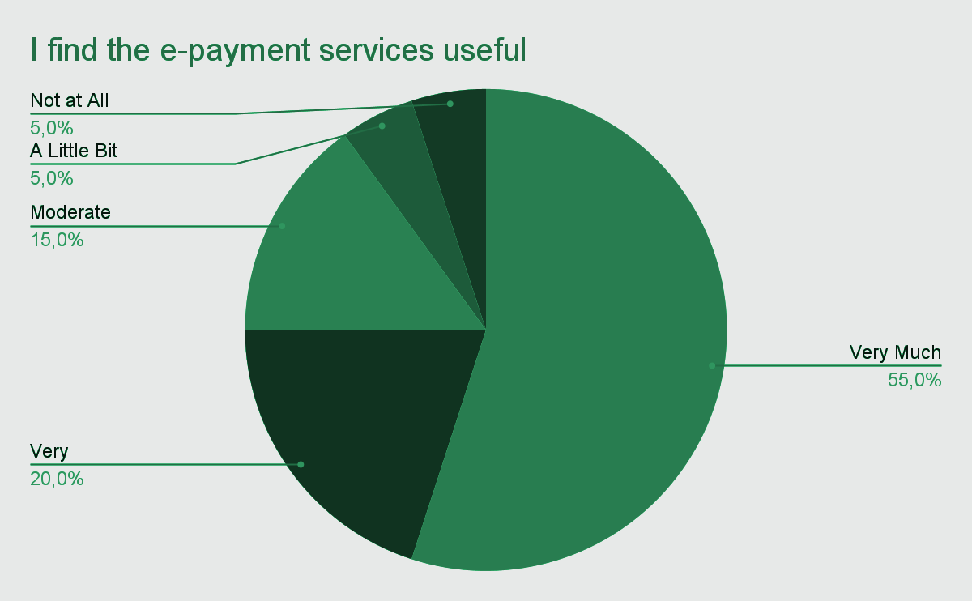
Participants also showed a strong preference for e-payment services

Slide 16
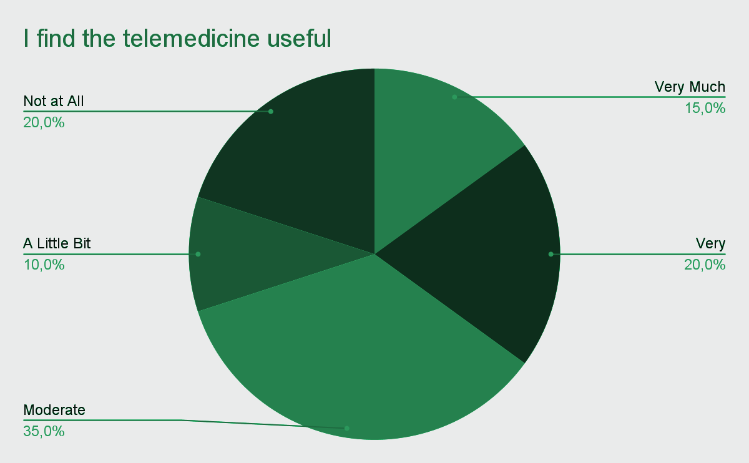
The majority of participants believe that telemedicine is useful

Slide 17
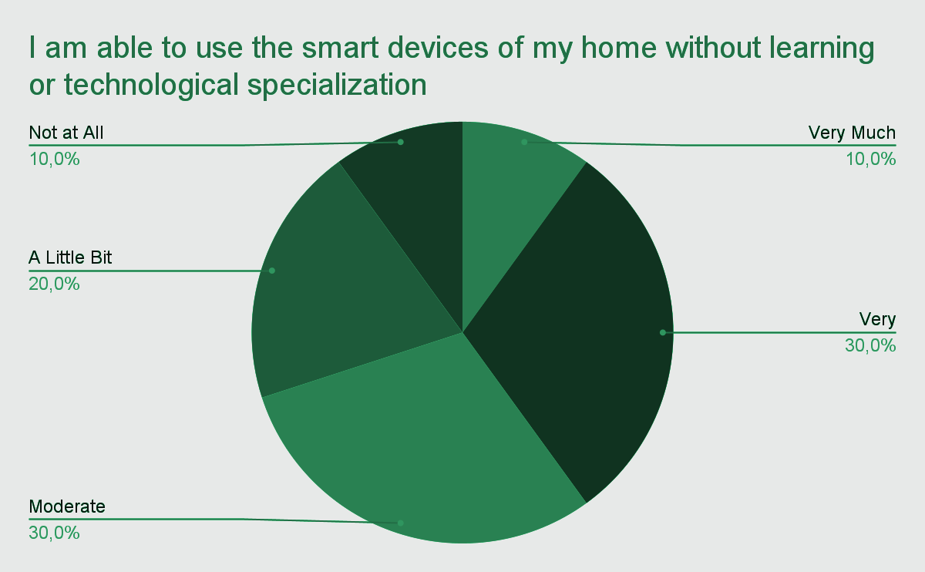
To a large extent, the participants feel able to use the smart devices of their home without having any technological expertise

Slide 18
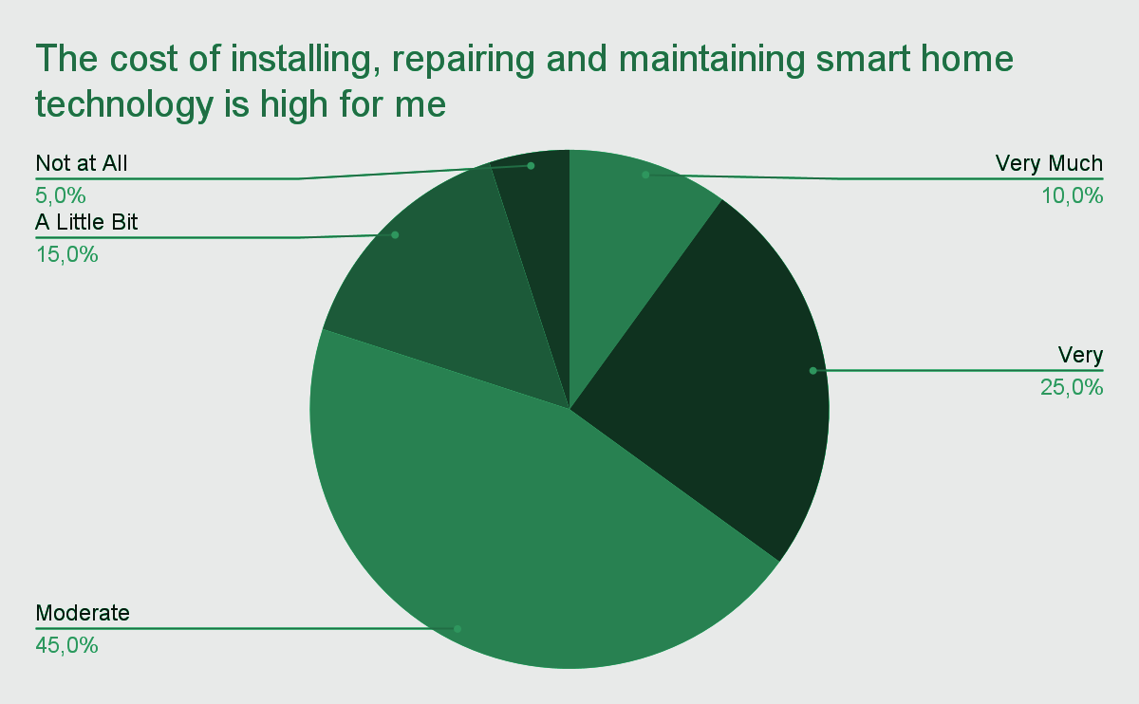
A large portion of participants believe that installation, repair and maintenance of smart home technology is high for them

Slide 19
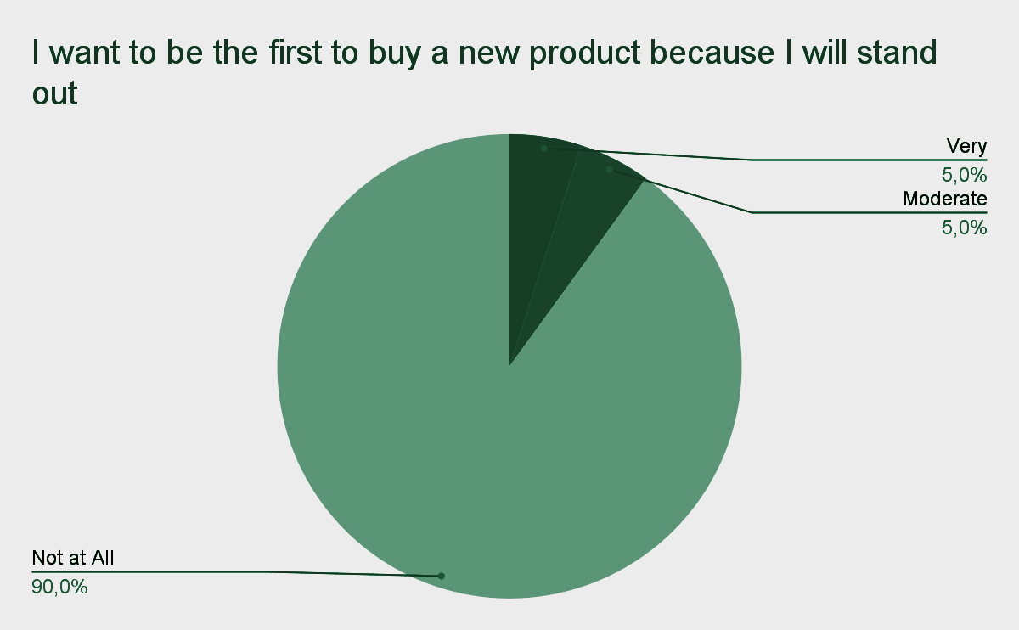
Nearly all participants agreed that social recognition was not a factor when purchasing a new product

Slide 20
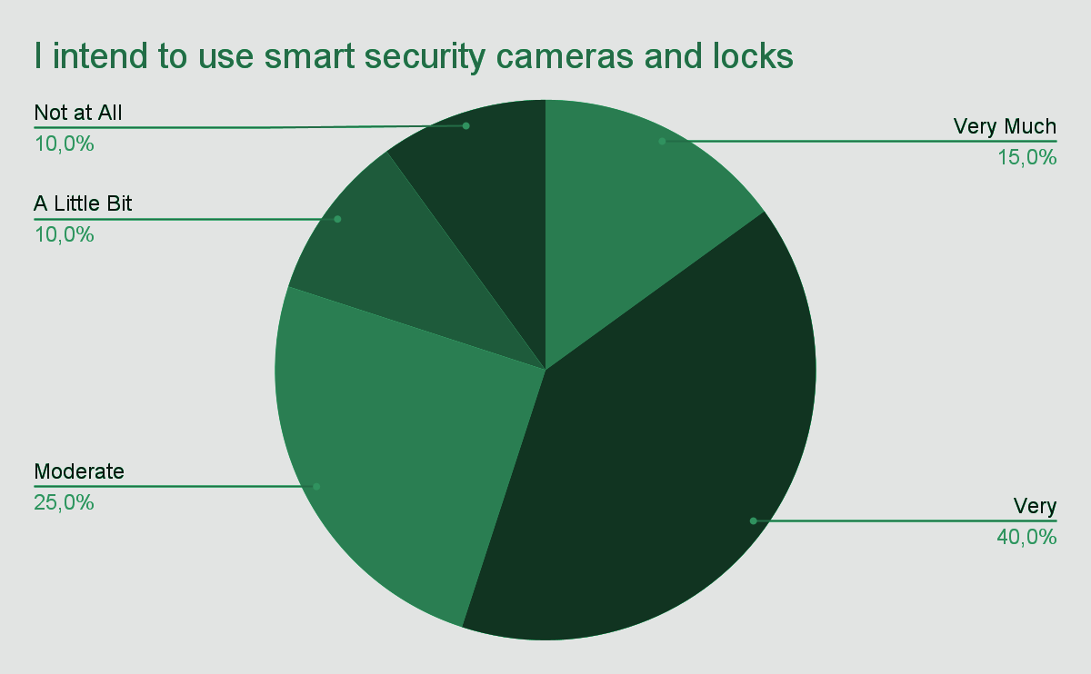
The majority of participants intend to use smart security cameras and locks

Slide 21
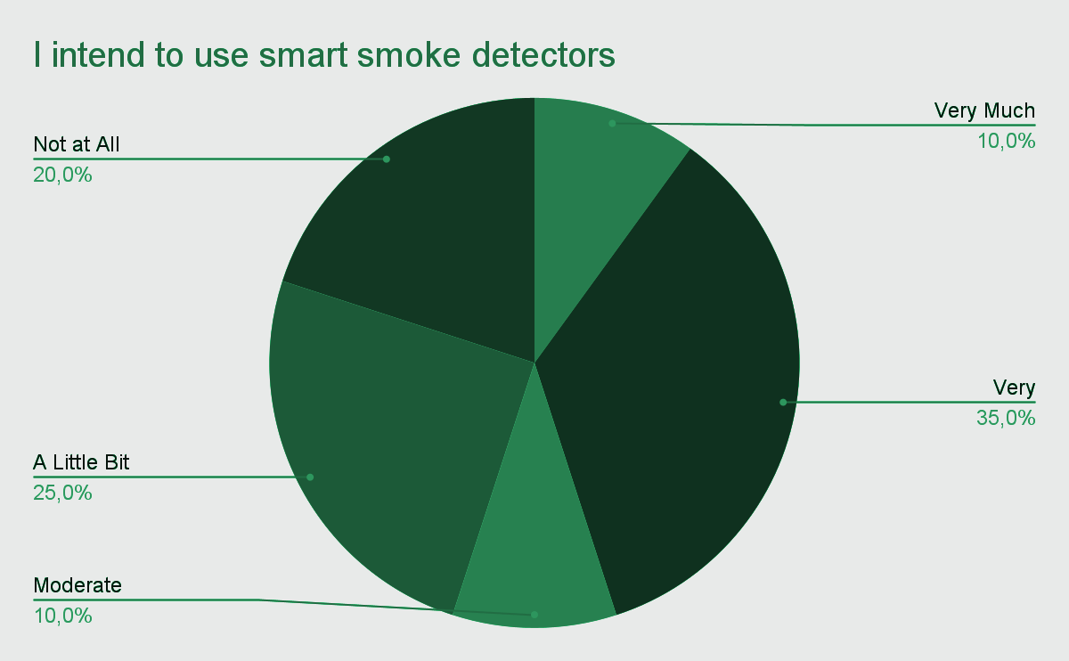
Participants showed moderate intent to use smart smoke detectors

Slide 22
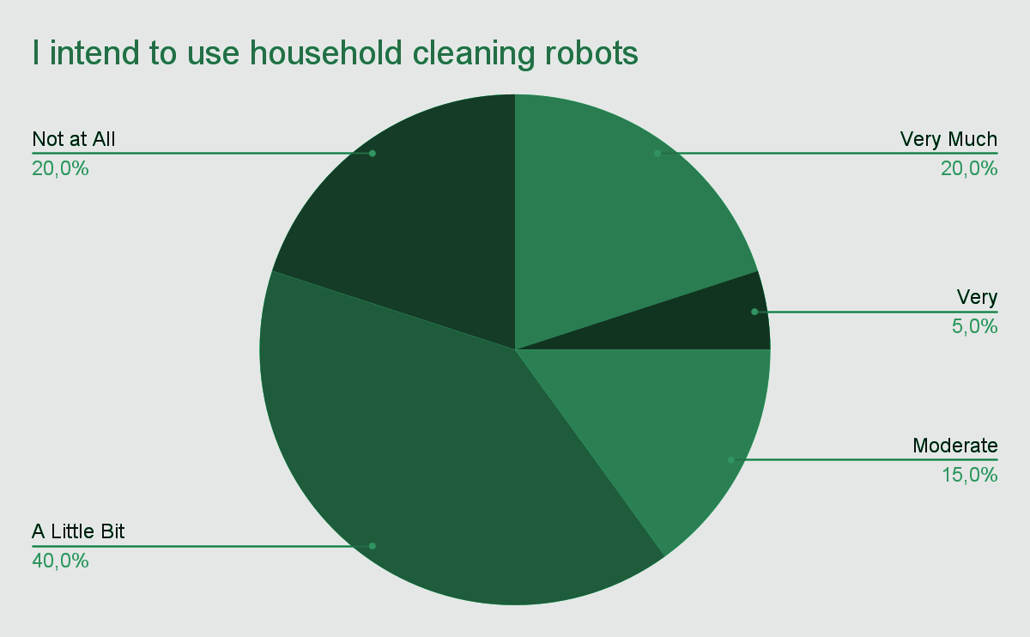
Participants showed low to moderate intent to use household cleaning robots

Slide 23
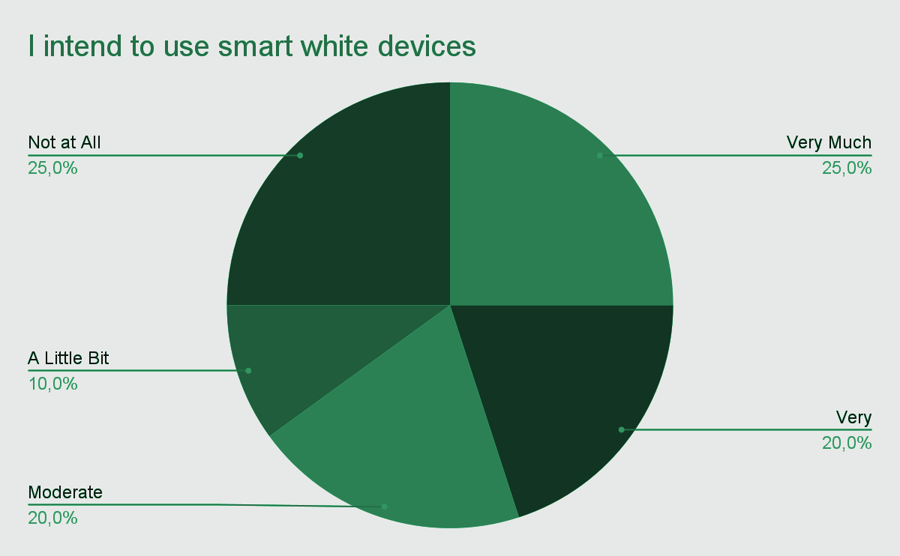
Participants showed moderate to high intent to use smart household appliances (Smart fridges, air conditioners, washing machines etc.)

Slide 24
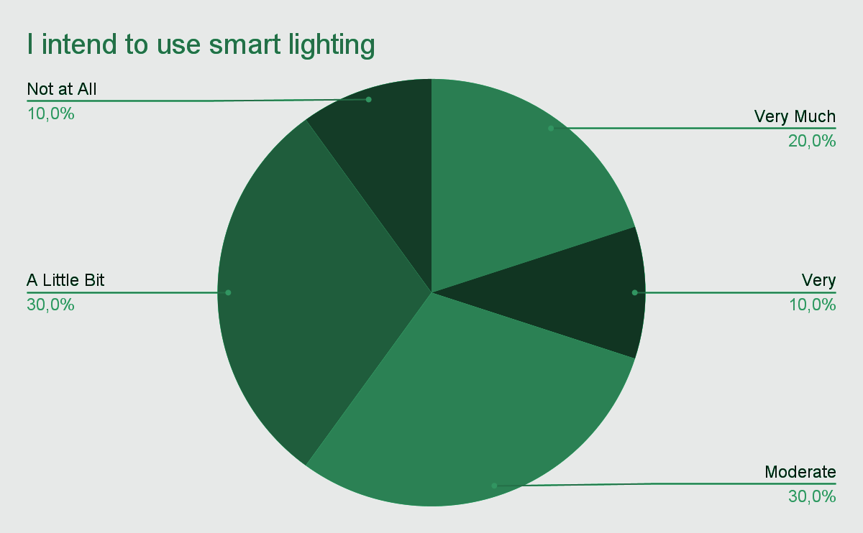
Participants also showed moderate intent to use smart lighting

Slide 25
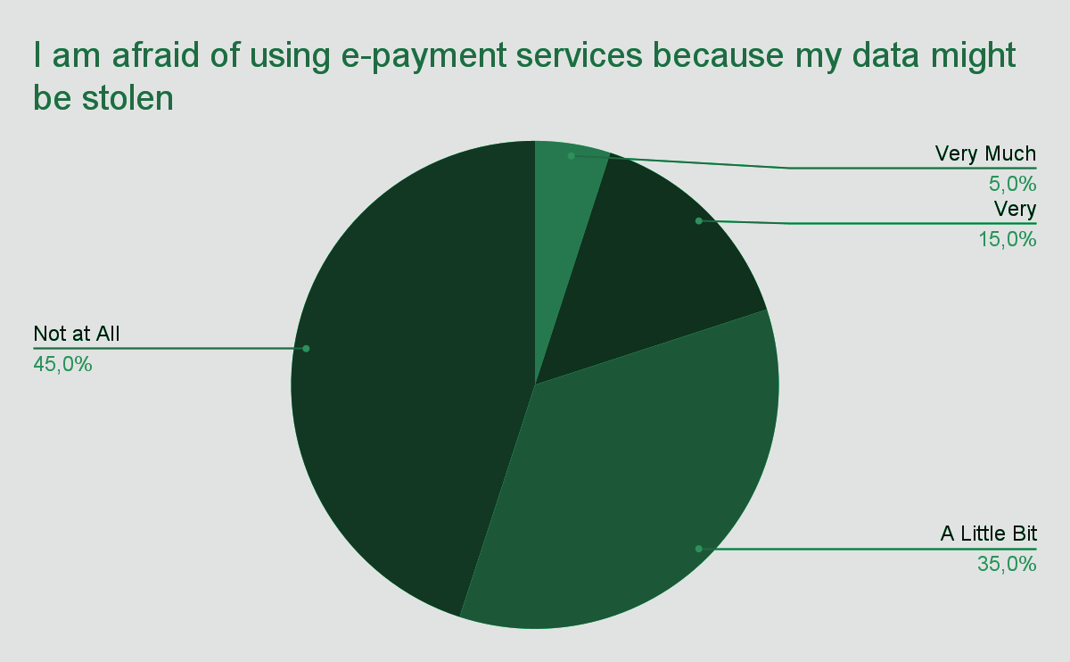
Participants are to a small extent afraid of having their data stolen when using e-payment services

Slide 26
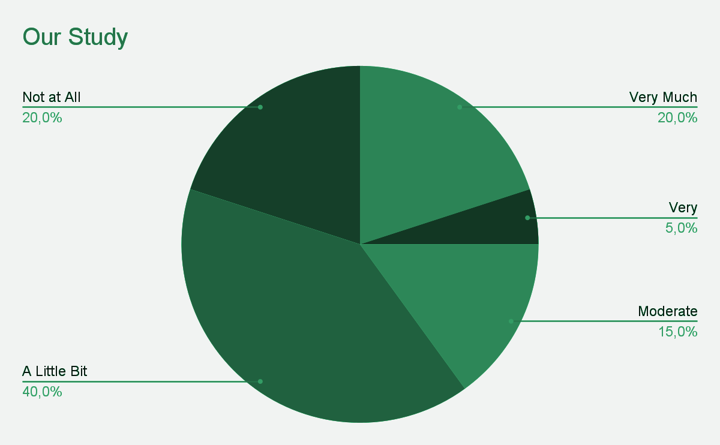
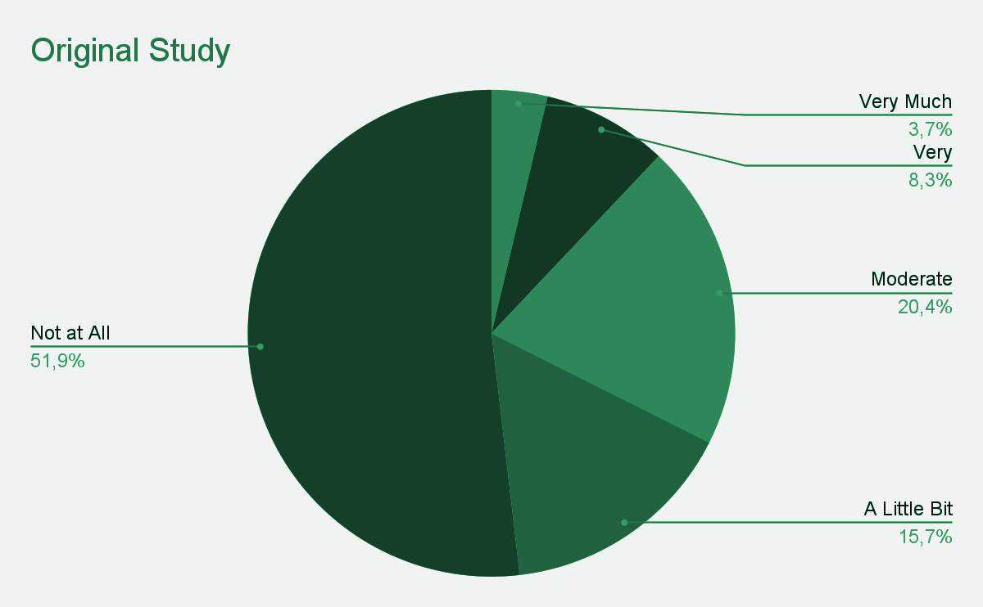
Comparisons
"I intend to use household cleaning robots”

Slide 27
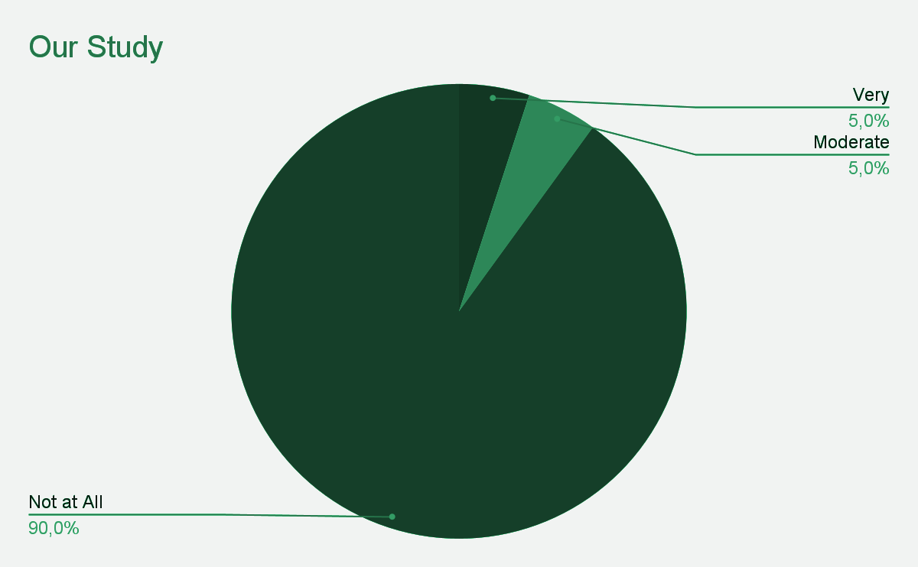
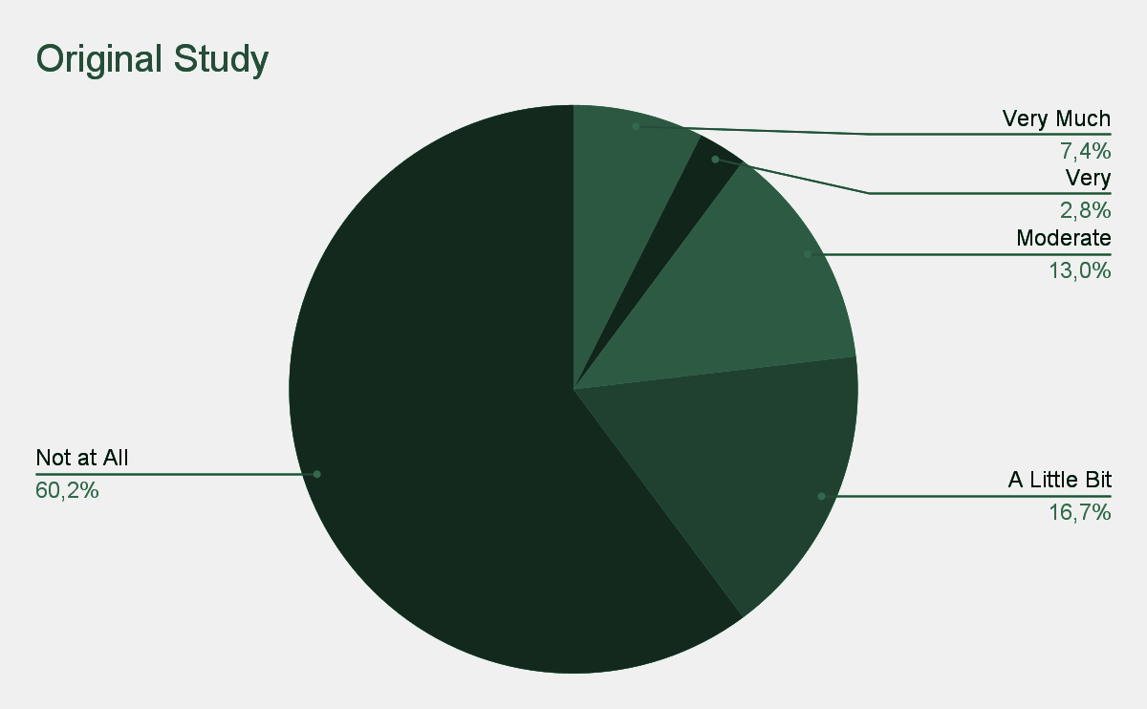
“I want to be the first to buy a new product because I will stand out”

Slide 28
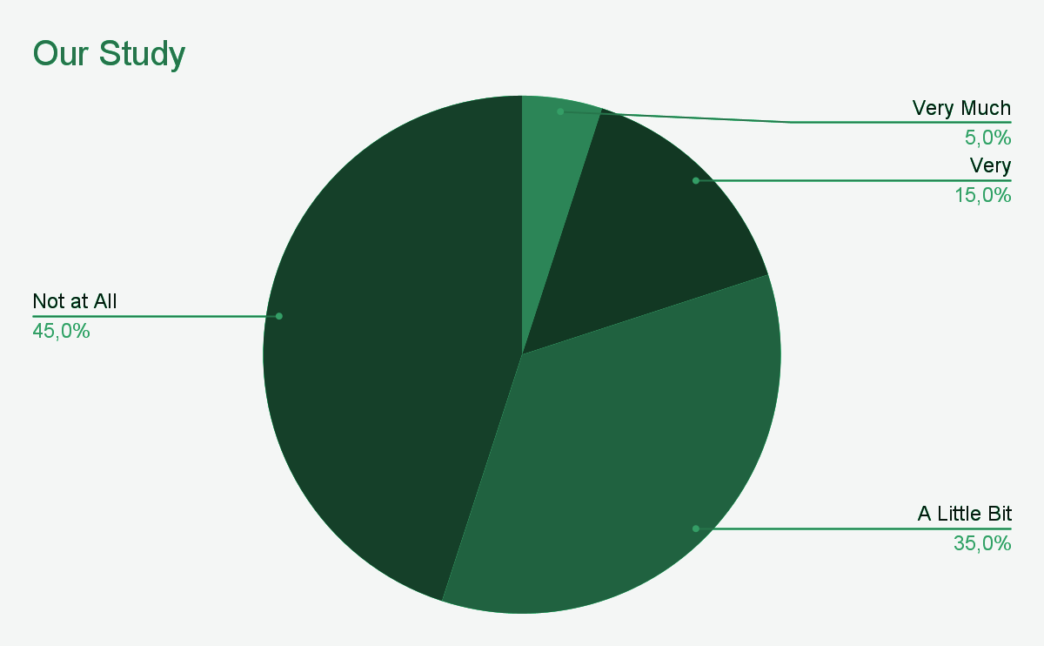
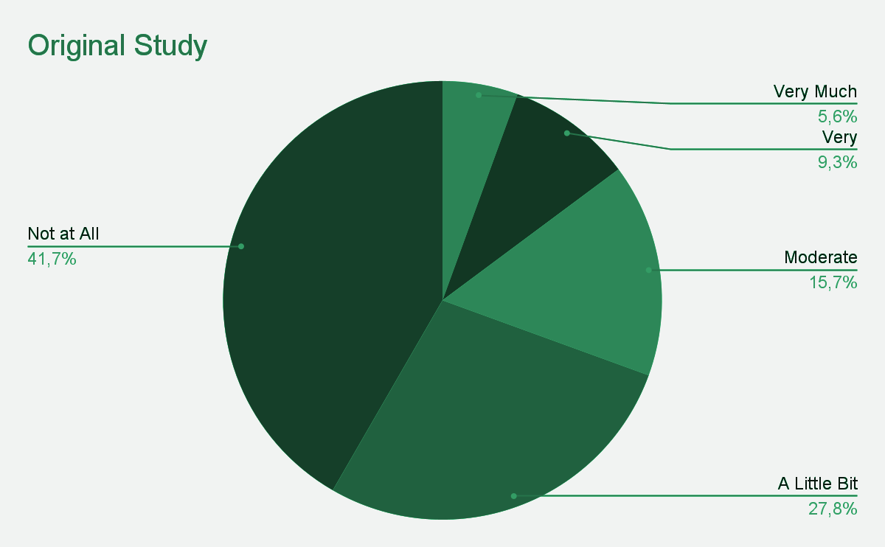
“I am afraid of using e-payment services because my data might be stolen”

Slide 29
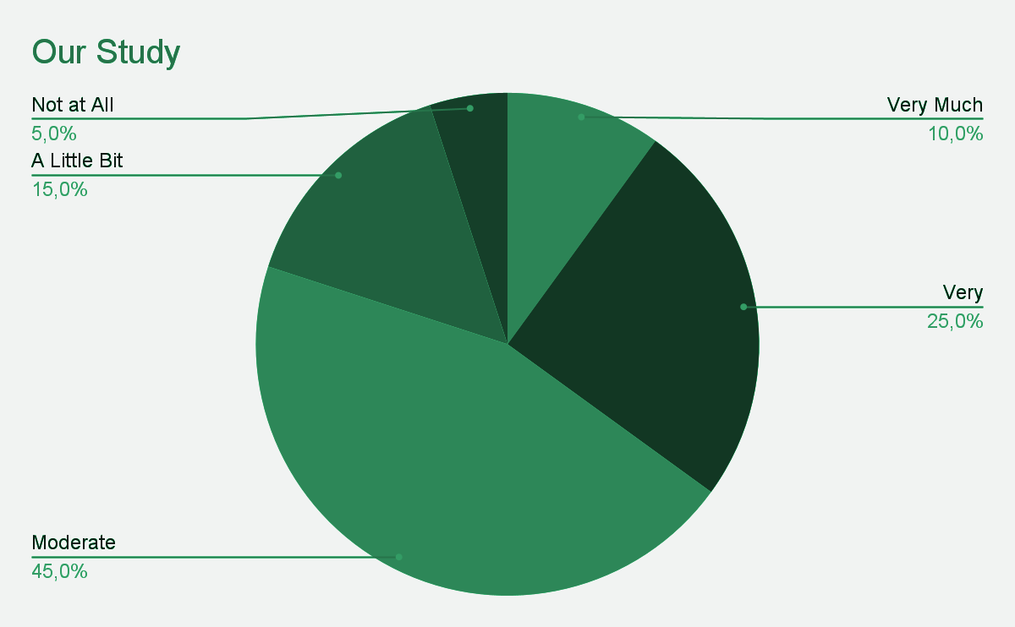
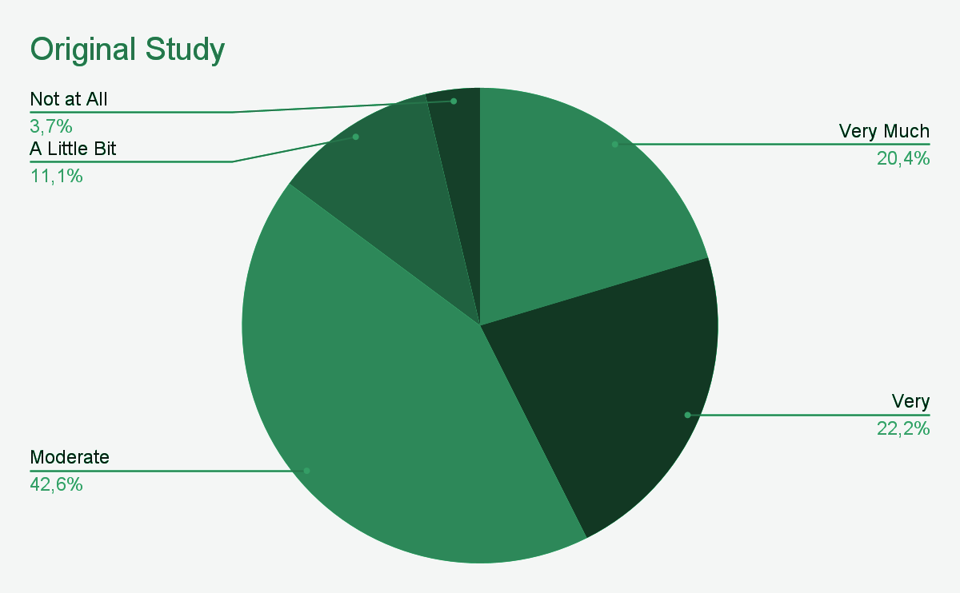
“The cost of installing, repairing and maintaining smart home technology is high for me”

Slide 30
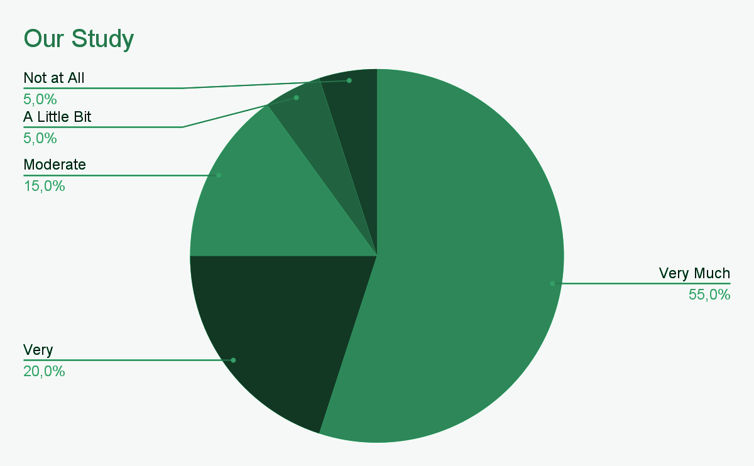
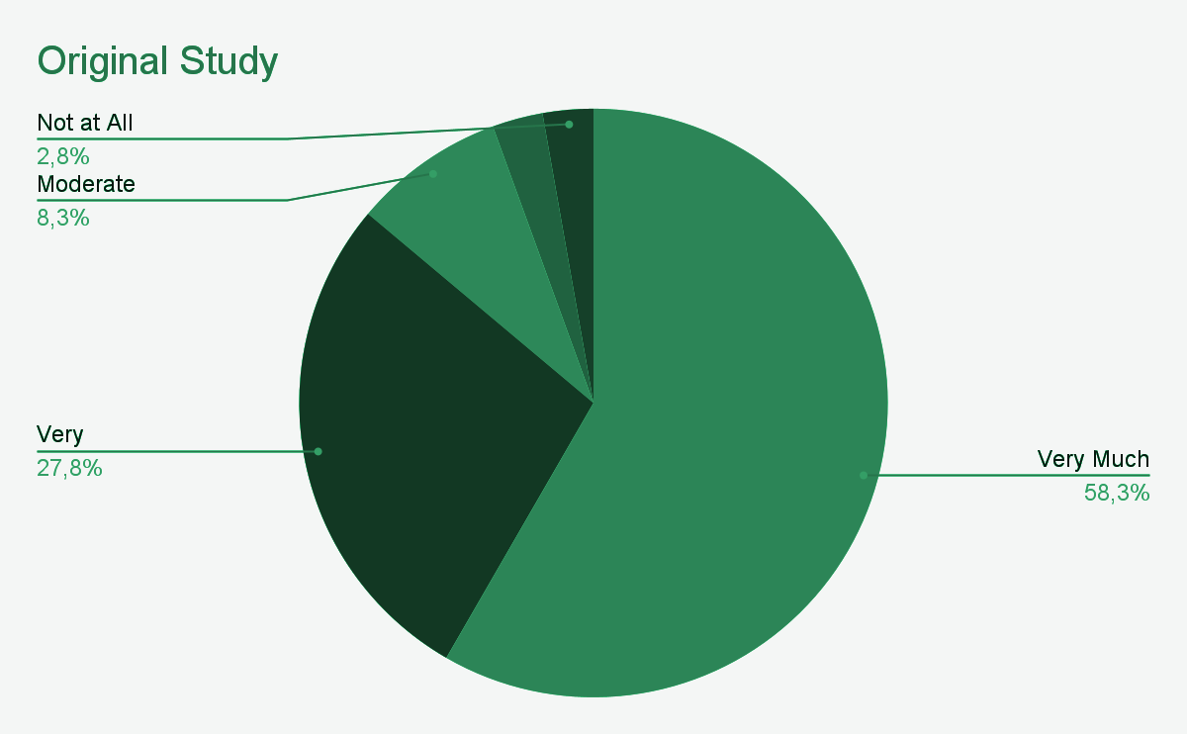
“I find the e-payment services useful”

Slide 31
Similarities Differences
High perceived cost of installing, repairing and maintaining smart home technology
Perceived usefulness of e-payment services
Fear of data loss when using e-payment methods
Desire to be the first to buy a new product for social recognition
Intention to use household cleaning robots

Slide 32
Our Reflection
Difficulties: Communication (distances of member’s houses)
Likes: Subject of the study, making the questionnaire
New Knowledge: Statistics and Technology Terms,
bullet point presentation

Slide 33
SOURCES
https://www.mdpi.com/2571-5577/5/1/26
Panayotis Pliatsikas & Anastasios A. Economides (2022). Factors Influencing Intention of Greek Consumers to Use Smart Home Technology. Applied System Innovation, 5(1), 26. https://doi.org/10.3390/asi5010026

Slide 34
Thank you for your attention!

